Slide 1
Collecting and storing data from Internet-based sources
Workshop :
Collecting and Storing Data from Internet-Based Sources
11 June 2018
Peter Smyth
Cathie Marsh Institute (CMI)

Slide 2
Workshop materials

Slide 3
Overview of this workshop
Getting data from the Internet using APIs
Accumulating data in a file or database for later use
Automating the processes on Windows and Linux
Notes:
Leave this for Peter

Slide 4
Overview
Web Services (APIs)
Data Sources
Collect using R
Collect using Python
Files
Database
Data Storage
Process using R
Process using Python

Slide 5
Overview
Breaking the overall process down into :
Collection
Storage
and Processing
We give ourselves options as to processing environments and to how we can accumulate data over time

Slide 6
Overview of this workshop
Getting data from the Internet using APIs
Accumulating data in a file or database for later use
Automating the processes on Windows and Linux
Notes:
Leave this for Peter

Slide 7
APIs
Description of an API
Examples of APIs
Finding and using API documentation
Browser based Demo of API usage
Code based demo of using an API
Notes:
Leave this for Peter

Slide 8
Wikipedia - API Definition
An API is a set of routines, protocols and tools for building software applications
It expresses a software component in terms of its operations, inputs, outputs and underlying types
An API defines functionalities that are independent of their respective implementations
A programmer can use the API to build an application
An API hides the complexity of implementation
Using an API allows the implementation to change, without affecting users
Notes:
Different language

Slide 9
What is an API?
It is a one off question and answer session
You ask a question
The Webservice sends you an answer

Slide 10
Why do we want to use an API?
To get information (Data)
Often data which can change over time
So the same request made at different times may give different answers
You will always ask the question in the same way
The format of the response will be the same, the content may be different

Slide 11
Scenario – Research Question
You want to track weather forecasts for a specific area
Over the same period, you want to collect Tweets mentioning weather in the area
Are their more tweets about good weather than bad weather?

Slide 12
Q & A - in human terms
What is the weather forecast/or observation for Glasgow
The weather for Glasgow on 6th of June 2018 was …..

Slide 13
Q & A - in API terms
Unfortunately computers are involved
so the formatting of the question and answer is not quite as straight forward
Q: http://datapoint.metoffice.gov.uk/public/data/val/wxfcs/all/json/3803?res=daily&key=0214dd6a-9ad5-4f34-8015-c0442079f40f“
A: {"SiteRep":{"Wx":{"Param":[{"name":"FDm","units":"C","$":"Feels Like Day Maximum Temperature"},{"name":"FNm","units":"C","$":"Feels Like Night Minimum Temperature"},{"name":"Dm","units":"C","$":"Day Maximum Temperature"},{"name":"Nm","units":"C","$":"Night Minimum Temperature"},{"name":"Gn","units":"mph","$":"Wind Gust Noon"},{"name":"Gm","units":"mph","$":"Wind Gust Midnight"},{"name":"Hn","units":"%","$":"Screen Relative Humidity Noon"},{"name":"Hm","units":"%","$":"Screen Relative Humidity Midnight"},{"name":"V","units":"","$":"Visibility"},{"name":"D","units":"compass","$":"Wind Direction"},{"name":"S","units":"mph","$":"Wind Speed"},{"name":"U","units":"","$":"Max UV Index"},{"name":"W","units":"","$":"Weather Type"},{"name":"PPd","units":"%","$":"Precipitation Probability Day"},{"name":"PPn","units":"%","$":"Precipitation Probability Night"}]},"DV":{"dataDate":"2018-06-06T09:00:00Z","type":"Forecast","Location":{"i":"3803","lat":"49.913","lon":"-6.301","name":"SCILLY ST MARYS","country":"ENGLAND","continent":"EUROPE","elevation":"31.0","Period":[{"type":"Day","value":"2018-06-06Z","Rep":[{"D":"NE","Gn":"11","Hn":"91","PPd":"9","S":"9","V":"GO","Dm":"17","FDm":"15","W":"7","U":"6","$":"Day"},{"D":"NNE","Gm":"13","Hm":"91","PPn":"31","S":"9","V":"GO","Nm":"14","FNm":"12","W":"7","$":"Night"}]},

Slide 14
Generic API
Application A
(a Web server)
Application B
(a program or web browser)
Request
Response
Notes:
Applications A and B could be anything
They both might :
Internal programs
Embedded software
A web service and a web browser

Slide 15
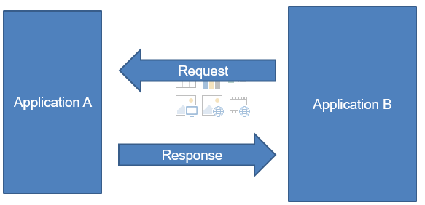
Who needs to know what?
Application B needs to be able to correctly format the requests and to be able to interpret the responses
Application A needs to be able to understand the requests and correctly return a response

Slide 16
Who doesn’t need to know what?
Application A doesn’t need know what application B does with the response
Application B doesn’t need to know how Application A create the responses from the requests

Slide 17
Who has an API ? - Some examples
Twitter
https://dev.twitter.com/
Facebook
https://developers.facebook.com/
Met Office
http://www.metoffice.gov.uk/datapoint
The Guardian
http://open-platform.theguardian.com/
Geonames API
http://api.geonames.org
Google Maps
https://developers.google.com/maps/
There are many more Google APIs, but the search API is
depreciated.

Slide 18
Finding APIs
Start at http://www.programmableweb.com
Search for ‘REST JSON’
View the results
Each result link will give further links to the documentation for the API
https://www.programmableweb.com/api/here-weather

Slide 19
Definitions
REST – REpresentational State Transfer
How the webservice is structured
Designed for easy navigation
Hence easy to formulate queries
JSON – JavaScript Object Notation
This is the data format of the returned data
It is a standard
It is based on ‘Key’ : ‘value’ pairs
Other formats are available – like XML
Or proprietary – best to avoid

Slide 20
JSON - Definition
JSON definition
Short for JavaScript Object Notation, JSON is a lightweight data-interchange format that is easy for humans to read and write, and for machines to parse and generate. JSON is based on the object notation of the JavaScript language.
What is JSON? Webopedia Definition
webopedia.com/term/j/json.html

Slide 21
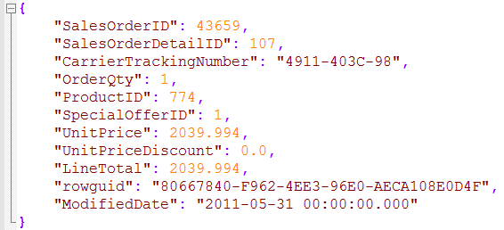
An example of simple JSON
This JSON file has been created by converting a csv file
You can always convert a csv file into JSON
Column Name
Column Value

Slide 22
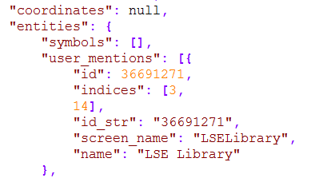
An example of complex JSON
This JSON is a very small part returned from a Twitter API call.
The nested structures “{…}” and more importantly the variable length arrays “[…]” make it very difficult to convert the JSON file into a csv file

Slide 23
An example of complex JSON
The contents of a complex JSON file is normally processed programmatically.
If you just wish to extract a few well defined fields, then the coding can be quite simple
This is often the case
But you will still need to understand the layout and types of the various fields to allow you to reference them correctly

Slide 24
Demonstration – Getting a Tweet
Code in ws_twitter_search.py

Slide 25
Recap - How do you use an API?
[Decide how to formulate the request]
Make a request
Get a response
[Work out how to interpret the response]

Slide 26
API Documentation
Essential to read and understand the API documentation
How to format requests
The format and contents of Responses
The use of keys
Limitations on use

Slide 27
API Documentation
Examples
Geonames
http://www.geonames.org/
Twitter
https://dev.twitter.com/rest/public
The Guardian
http://open-platform.theguardian.com/

Slide 28
Demonstration
Another API call – try this in IE, Chrome and Firefox
http://api.geonames.org/postalCodeCountryInfoJSON?username=PeterSmyth

Slide 29
Demonstration
Older versions of Browsers had difficulty dealing with JSON
Some (IE) would just return a string of text
Newer versions are more JSON-aware and will offer some kind of formatting.

Slide 30
Demonstration - metoffice.py
Using the met office datapoint API in Python
Show results to the screen
Writing the results to a file
We are using the Python requests module to access the API.
All of the data returned by the API is available to us
This could be a convenience or a problem
We need to be able to extract the data that we want

Slide 31
Q & A - in API terms
Q: http://datapoint.metoffice.gov.uk/public/data/val/wxfcs/all/json/3803?res=daily&key=0214dd6a-9ad5-4f34-8015-c0442079f40f“
A: {"SiteRep":{"Wx":{"Param":[{"name":"FDm","units":"C","$":"Feels Like Day Maximum Temperature"},{"name":"FNm","units":"C","$":"Feels Like Night Minimum Temperature"},{"name":"Dm","units":"C","$":"Day Maximum Temperature"},{"name":"Nm","units":"C","$":"Night Minimum Temperature"},{"name":"Gn","units":"mph","$":"Wind Gust Noon"},{"name":"Gm","units":"mph","$":"Wind Gust Midnight"},{"name":"Hn","units":"%","$":"Screen Relative Humidity Noon"},{"name":"Hm","units":"%","$":"Screen Relative Humidity Midnight"},{"name":"V","units":"","$":"Visibility"},{"name":"D","units":"compass","$":"Wind Direction"},{"name":"S","units":"mph","$":"Wind Speed"},{"name":"U","units":"","$":"Max UV Index"},{"name":"W","units":"","$":"Weather Type"},{"name":"PPd","units":"%","$":"Precipitation Probability Day"},{"name":"PPn","units":"%","$":"Precipitation Probability Night"}]},"DV":{"dataDate":"2018-06-06T09:00:00Z","type":"Forecast","Location":{"i":"3803","lat":"49.913","lon":"-6.301","name":"SCILLY ST MARYS","country":"ENGLAND","continent":"EUROPE","elevation":"31.0","Period":[{"type":"Day","value":"2018-06-06Z","Rep":[{"D":"NE","Gn":"11","Hn":"91","PPd":"9","S":"9","V":"GO","Dm":"17","FDm":"15","W":"7","U":"6","$":"Day"},{"D":"NNE","Gm":"13","Hm":"91","PPn":"31","S":"9","V":"GO","Nm":"14","FNm":"12","W":"7","$":"Night"}]},

Slide 32
Twitter Examples
You need to have a Twitter account to use the API
You need a set of 4 keys
Keys are obtained by creating an application
The starting point is https://apps.twitter.com/

Slide 33
Demonstration – ws_twitter_search.py
The JSON returned by the Twitter API is more complex
A full tweet is very complex and can be over 4Kb in size
We will look at a simpler structure
What is trending

Slide 34
Demonstration – ws_twitter.py
Rather than using the full Tweet, we will look at a simpler structure
What is trending
Research Question
How do trends change over time?
Do trends ‘flow’ around the world?

Slide 35
Exercise
The code that we have already seen in the ws_twitter_search.py file will collect tweets containing a given keyword
Try different keywords, perhaps hashtags.
Write the complete tweets to a file
From an example of a returned tweet, identify fields that you might want to collect and write them to a file

Slide 36
Overview of this workshop
Getting data from the Internet using APIs or file downloads
Accumulating data in a database for later use
Automating the processes on Windows and Linux
Notes:
Leave this for Peter

Slide 37
Storing data
Having downloaded data from an API, we have options as to what we do with it – and when.
We can :
Process the data immediately in the same script as we downloaded it in
Store the JSON in file as JSON for later use
Extract fields from the JSON and save in a CSV file for later use
Extract fields from the JSON and save in a Database for later use

Slide 38
Storing Data
Advantages of storing the data include:
Use different programming environment to process the data
Move the data
Reproduce the analysis at a future date
Append to the data over time

Slide 39
Storing Data
Raw JSON v selected fields in CSV – pros and cons
Storing all of the raw JSON will take up more space
If you have the raw JSON, you can change your processing to use other available fields
Storing selected fields in CSV or in a database saves space
Your processing will be restricted to using the saved fields.
May not have a choice if using a package
twitter or googlefinance

Slide 40
Database Options
Both Python and R can be interfaced to a variety of commercial and open source database systems
Both have support for SQLite
Don’t be confused by the ‘Lite’ part; an SQLite database can be Terabytes in size and have tables with millions of rows.
There is no provided management user interface to SQLite, but 3rd party options are available
Like DB Browser.

Slide 41
Storing Data - Demonstrations
We have already stored selected fields from the JSON into a file from the metoffice datapoint API
We will now look at:
Storing selected fields from the JSON into an SQLite database
Using the Twitter woeids data

Slide 42
Storing Data
Unlike the case where we simply wrote a CSV file, in order to use a database table, we first have to define a Schema for it.
The Schema is simply the description of the fields (columns) in the table and the type of data which they contain
This can be created directly using DB Browser

Slide 43
Storing Data
Or by using code. ( sqlite_twitter_01.py )
We can then populate the table (sqlite_twitter_02.py )
We can query the data in the database table (sqlite_twitter_03.py)
Using R
The twitter module in R has simple built-in support for writing Twitter data to an SQLite database and retrieving it. (twitter_sqlite.R)

Slide 44
Exercise
We need to create a database for the metoffice datapoint data
Using either DB Browser or Python code (based on sqlite_twitter_01.py), create a schema for the table we need to store the data
Using the code from xxx.py and sqlite_twitter_02.py, create code to write the minimum and maximum day and night temperatures for the 5 day forecast for Glasgow??

Slide 45
Overview of this workshop
Getting data from the Internet using APIs or file downloads
Accumulating data in a database for later use
Automating the processes on Windows and Linux
Notes:
Leave this for Peter

Slide 46
Reminder – Research Question
You want to track weather forecasts for a specific area
Over the same period, you want to collect Tweets mentioning weather in the area
Are their more tweets about good weather than bad weather?

Slide 47
What is involved?
Forecasts and observations are available daily. The forecasts are split into 3 hour periods. We can download the data on a daily basis
We want to make a call to search twitter for our locations, perhaps using specific weather related search once every hour.
(This is not really an ideal solution to the problem, It is just being used to highlight the potential problems)

Slide 48
Automating processes
You can run your data collection manually
At the keyboard every morning a 9:00am
You do get instant feedback on errors
But several time day and night?
Not very convenient
Both Windows and Linux provide methods to automate the running of jobs
The machine has to be powered up
But you don’t necessarily need to be logged on

Slide 49
Automation - Windows
The automation system in Windows is called Task Scheduler
Windows makes extensive internal use of the Task Scheduler
But it is also available to the end user (providing appropriate permissions are set)
It has a GUI interface

Slide 50
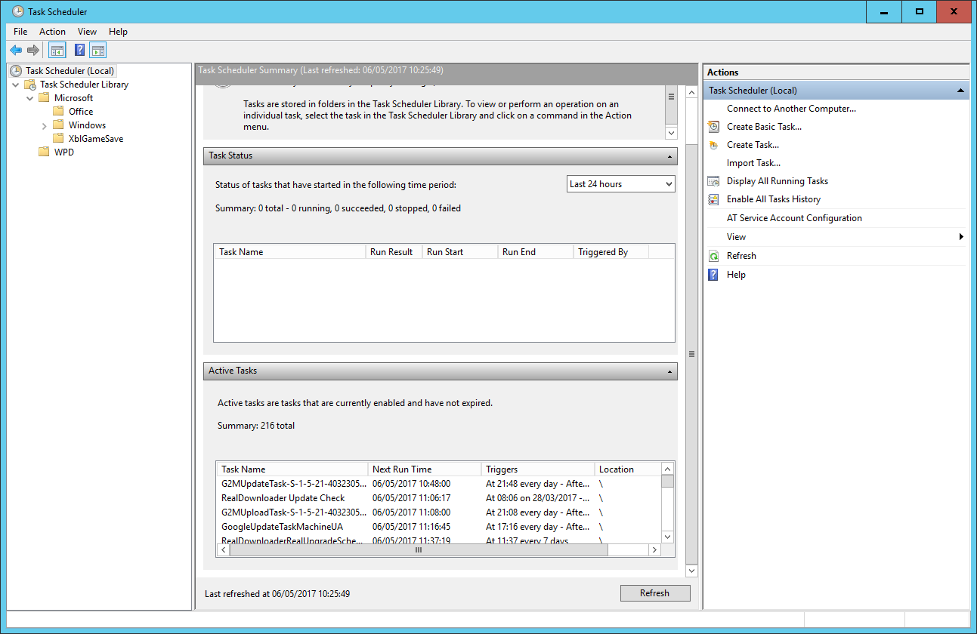
Automation - Windows
Task Scheduler GUI

Slide 51
Automation - Windows
The left-hand pane is a directory tree of folders
You can create your own folders
The centre section provides information on the item currently selected
In this Windows 10 system there are currently 216 active tasks
Installed applications may add tasks to regularly check for updates.
The right-hand pane provides a list of commands
We want to create a new task

Slide 52
Automation - Windows
Demonstration
Have a notepad file open everytime the user logs in
Steps:
Create a notepad file called Log.txt on the desktop and write .LOG into the first line and save it.
Open Task Scheduler
Create a folder under the Windows folder with your name and select it
Create a new task to open the Log.txt file everytime you log in

Slide 53
Automation - Linux
In a Linux system the automation process is known as CRON
Details of the tasks to be run are in a file called the crontab.
There is a systemwide crontab, but each user can make use of their own personal crontab
The formatting of the lines in the crontab is critical
You edit the crontab file with the command:
crontab –e
This either opens the existing crontab or creates a new one

Slide 54

Automation - Linux
The crontab file is opened in your choice of editor

Slide 55
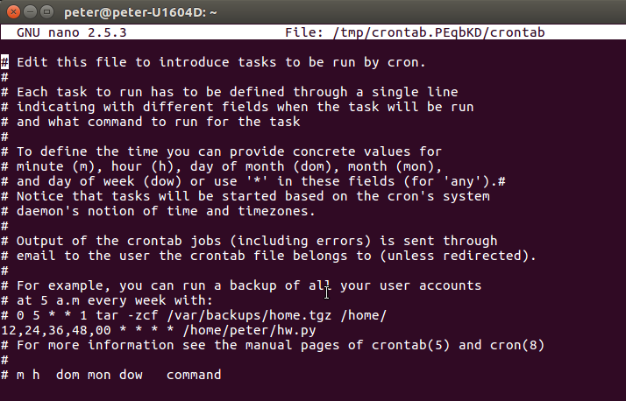
Automation - Linux
The default crontab file includes instructions as to how to complete a line
Only the highlighted line has been added

Slide 56
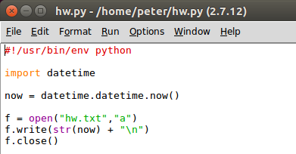
Automation - Linux
The line indicates that the program hw.py in the folder /home/peter should be run at 00,12, 24, 36 and 48 minute of every hour of every day – forever!
The program hw.py is very simple – writing a timestamp string to the file hw.txt

Slide 57
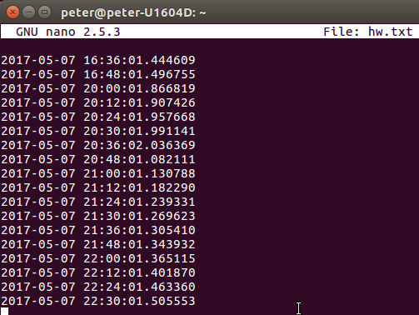
Automation - Linux

Slide 58
Automation - summary
Automation is useful for any kind of timed event which s repetitive on a known schedule.
It can be used to accumulate data from sources where the available data changes on a regular basis
Stock market
Weather
Tweets
You can construct simple workflows with one automated task being dependent an another
E.g one task selects a trending search term in twitter daily and another collects tweets based on that at hourly intervals

Slide 59
Peter Smyth
Peter.smyth@manchester.ac.uk
The Cathie Marsh Institute (CMI) (www.cmist.manchester.ac.uk)

